Slide 1
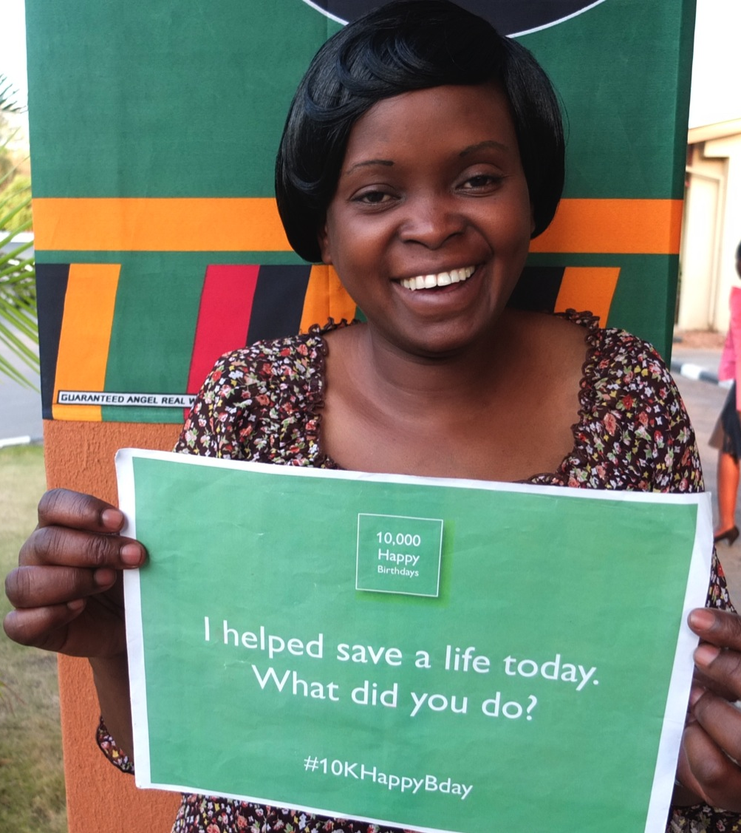
10K Happy Birthdays by Rotary Project
Led by Rotarians
D2250 in Norway
Rotary Club of Bwaila, Malawi (District 9210)
Rotary Club of Lusaka Central, Zambia (District 9210)
Based on an identified real local needs in Zambia and Malawi through Rotary Host Clubs
Application for TRF’s Global Grant will be submitted in 2017
Sustainability of the project will be ensured by anchoring it locally with the Rotary Clubs and the national midwifery associations and the International Confederation of Midwives (ICM).
Notes:
Big thanks to the midwifery organizations in Malawi and Zambia, and ICM for the very good work that has been done so far.
In addition to Helping Babies Breathe and stopping mothers bleeding, eclampsia and pre-eclampsia are also included as part of the training.

Slide 2
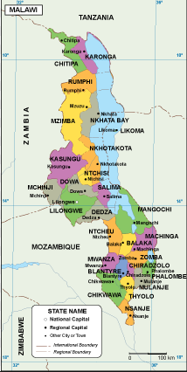
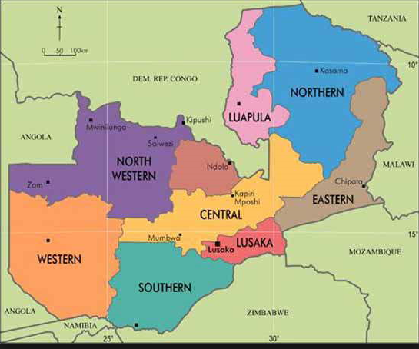
10K Happy Birthdays by Rotary Project
 | Zambia 2015 | Malawi 2015
Capital City | Lusaka | Lilongwe
Total population (million) | 16,2 | 17,2
Total live births | 645.000 | 665.000
Maternal Mortality Rate (MMR) | 224 per 100.000 LB | 634 per 100.000 LB
Newborn Mortality Rate (NMR) | 21 per 1000 LB | 22 per 1000 LB
MALAWI
ZAMBIA

Slide 3
10K Happy Birthdays by Rotary Project
Project objectives:
To train up to at least 1500 midwives and other birth attendants in two new modules Essential Care for Small Babies (ECSB) and Pre-Eclampsia (Eclampsia (PEE) Malawi and Zambia.
Ensure skill maintenance and quality improvement of lifesaving skills at birth of those already trained in basic project modules. (Helping Mothers Survive HMS-BAB and helping babies breath HBB).
Enhance uptake and institutionalization of the programs in facilities and midwifery schools in Malawi and Zambia.
Develop format/template of project to be replicated to neighboring countries

Slide 4
10K Happy Birthdays by Rotary Project
Activity Status
DG Christin Landmark visited Host Clubs in July 2017 to secure their commitment
Application for TRF GG (draft) online
NOK 500.000 raised by 23 Rotary clubs in D2250, private rotarymembers and D2250. Matched with LGH – total NOK 1.000.000.
Submit final application within Sept/Oct. 2017.

Slide 5
10K Happy Birthdays by Rotary Project
Work schedule:
The project be implemented according to the project plan that all partners and TRF have agreed upon.
Project plan will be periodically reviewed with the Project Board and Project Committee.
Regular communication with Rotary partners and collaborating organizations.
Regular updates to Project Board, collaborating organizations, involved community members, club members and other interests parties.
Information to stakeholders periodically of progress, evt deviations, challenges and solutions etc.
All in accordance with Global Grant regulations etc.
Notes:
Big thanks to the midwifery organizations in Malawi and Zambia, and ICM for the very good work that has been done so far.
In addition to Helping Babies Breathe and stopping mothers bleeding, eclampsia and pre-eclampsia are also included as part of the training.

Slide 6
10K Happy Birthdays by Rotary Project
DG 2250 visit to Malawi and Zambia
Motto for Ethel Mutharia Maternity Wing
Lilongwe, Malawi

Slide 7
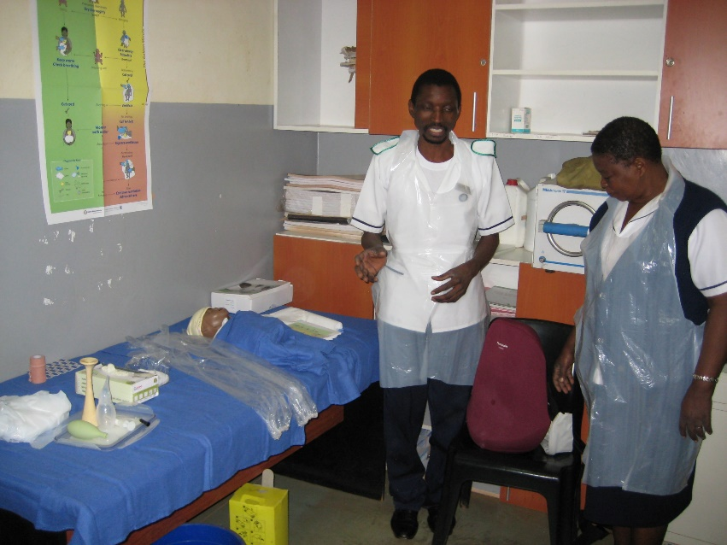
10K Happy Birthdays by Rotary Project
DG 2250 visit to Malawi and Zambia
Ethel Mutharia Maternity Wing i Lilongwe, Malawi, where Rotarian Dr. Ann Phoya was a leader.
One Happy Birthday: DG Christin Landmark and dr Ann Phoya was brought in meanwhile we were there. The mother was given life thanks to training through program.
Notes:
Pic on the left: Ethel Mutharia Maternity Wing i Lilongwe, Malawi, hvor dr Ann Phoya var leder. Det var flere mannlige jordmødre.
Pic on the right: DG D2250 and Rtn. Ann Phoya of the Rotary Club of Bwaila, Malawi

Slide 8
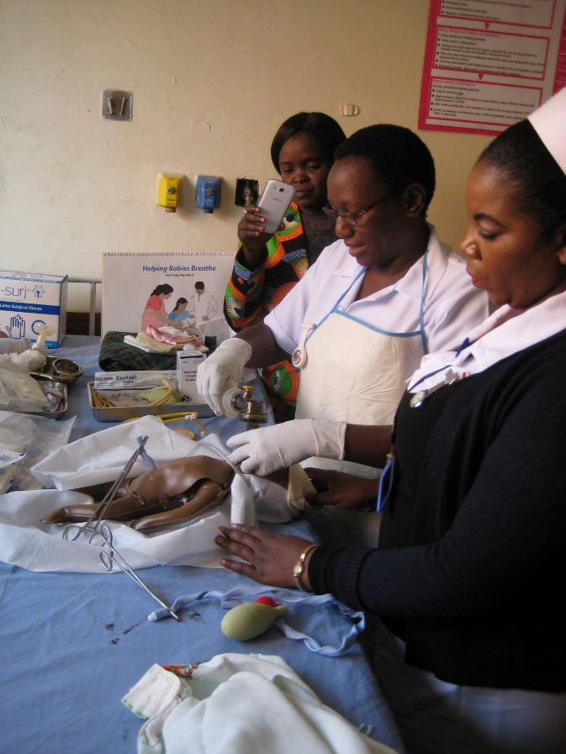
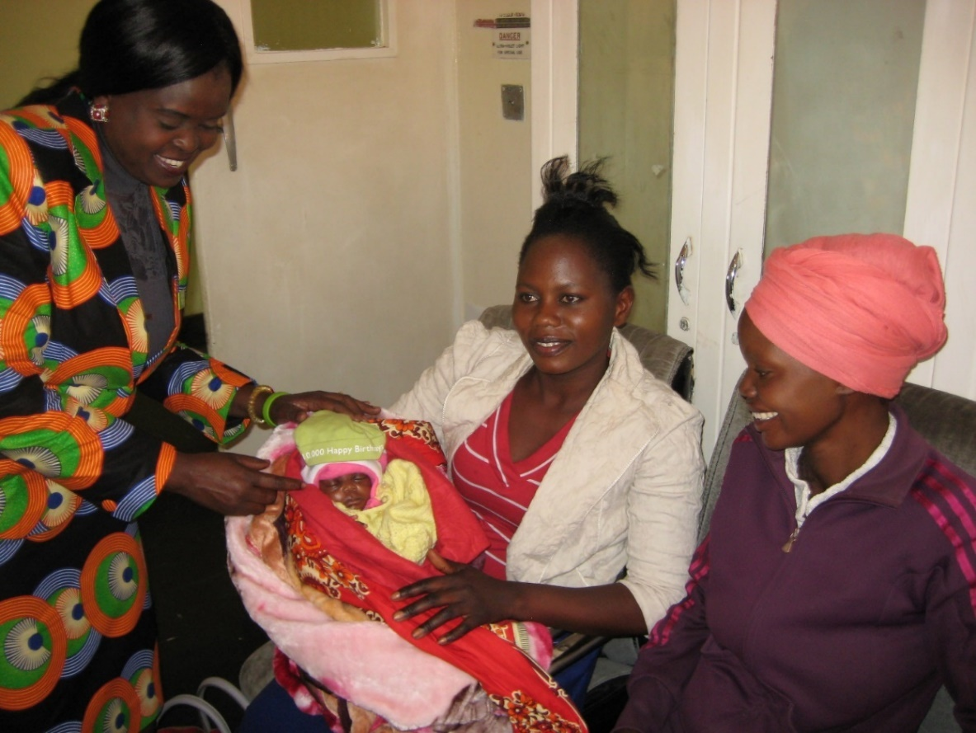
DG D2250 visit to a hospital at Lusaka, Zambia
10K Happy Birthdays by Rotary Project
Lusaka: A newborn baby was given life thanks to training through the program.
Here with midwife Catherine Zanka; a dedicated and very competent midwife.
Lusaka: Training room
Notes:
Pic on the left: Women and Newborn Hospital i Lusaka, Zambia. Opplæringsrommet. Til dette sykehuset kommer kvinner med kompliserte fødsler.
Pic on the right: En helt nyfødt baby som takket være trening av jordmødrene fikk leve. Her sammen med Catherine Zanka; en enestående og dedikert jordmor.

Slide 9
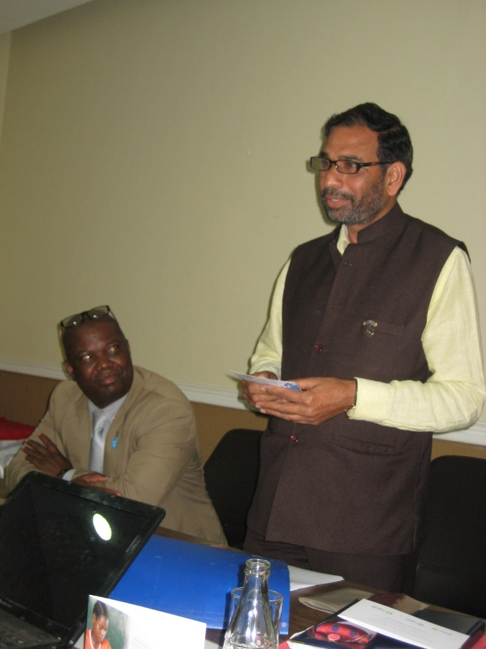
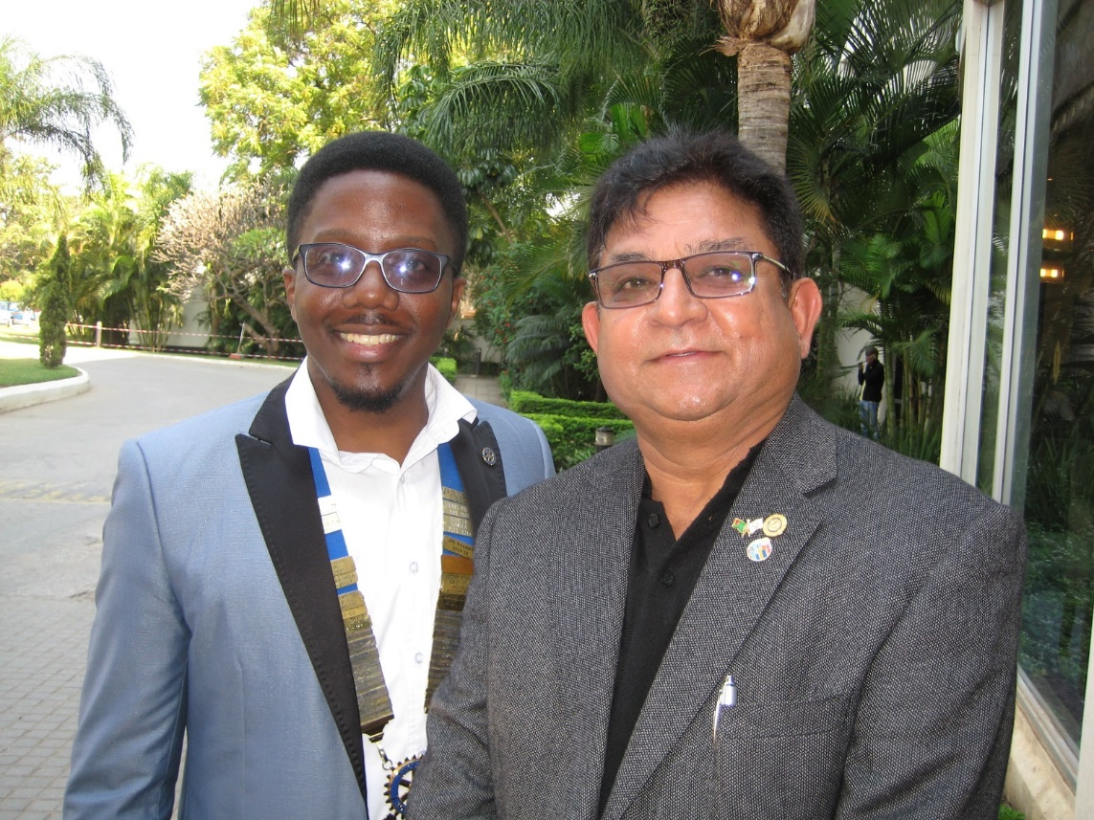
Representatives from 10K HB Host Clubs
10K Happy Birthdays by Rotary Project
Rotary Club of Lusaka Central, Zambia
President Onechi Livenje & Past President Arun Mohan
Bwaila Rotary Club, Lilongwe, Malawi
President Vijay Mittal & Rtn. Innocent Mofolo

Slide 10
10K Happy Birthdays by Rotary Project Provided continued engagement in D2250,
Expand it to other Rotary Districts in Norway and further to Scandinavia/Europe in the long term
In the future, engage other Rotary institutions; for example RFPD (Rotary Action Group for Population & Development).
Use existing capacity from Malawi/Zambia in supporting roll, duplicate the program(s) in a new country
Replicate the project in another country with great success.
Notes:
Eclampsia and pre-eclampsia is also included as part of the training.

Slide 11
10K Happy Birthdays by Rotary Project Provided continued engagement in D2250,
Successful implementation:
The project will contribute to the reduction of maternal and neonatal deaths and mobidity in Malawi and Zambia.
Midwifery school in selected districts in both countries will be able to serve as centers of excellence for education and training in all four modules
Notes:
Eclampsia and pre-eclampsia is also included as part of the training.

Slide 12
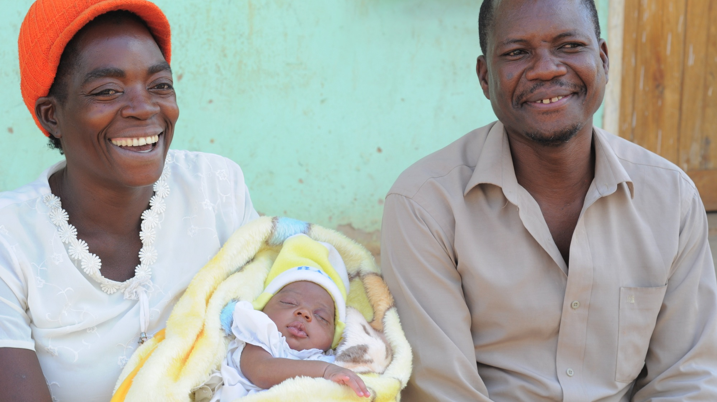
10K Happy Birthdays by Rotary Project ULTIMATE GOAL:
'One million Happy Birthdays by Rotary‘

