Slide 1
District Conference D2250 at Sola Strand Hotel 22-24 September 2017
Greetings
from The President of Rotary International
Some of his assignments and priorities
- Engaging Young Leaders + Women in Rotary + Plant a tree
- Issues and Aspects of Rotary
- RI Motto 2017/18
PDG Robert Zinser, Representative of RI President Ian H.S. Riseley
CEO - Rotarian Action Group for Population & Development

Slide 2
District Conference D2250 at Sola Strand Hotel 22-24 September 2017
Tema: Menneskeverd – menneskeverdighet
“Human Dignity”
Together we are strong and
Make a Difference
PDG Robert Zinser, Representative of RI President Ian H.S. Riseley
CEO - Rotarian Action Group for Population & Development

Slide 3
HUMAN DIGNITY – “Most important Human Right from which all other fundamental rights derive” (UN) ● Compliment for this Theme – Human dignity highest moral principle, inviolable ● Human dignity harmed when people marginalized, ignored, devalued, tortured, raped, socially excluded ● Human Dignity requested for SDGs, reflected in AoFs - Contribution to a peaceful world through ethical orientation - AoF MCH similar to SDG 3, value driven by Human Dignity (Globethics.net) ● Rotary’s Four Way Test – Ethically justified actions ● Rotary representing community of values -Golden rule

Slide 4
Object of Rotary (RI Principles) ● Emphasizing service activities by individuals and groups ● that enhance the quality of life and human dignity, ● Encouraging high ethical standards, ● and creating greater understanding among all people ● to advance the search for peace in the world

Slide 5
HUMAN DIGNITY “Human dignity is the same for all human beings: when I trample on the dignity of another, I am trampling on my own”. (Pope Francis) “The rapprochement of peoples is only possible when differences of culture and outlook are respected and appreciated rather than feared and condemned, when the common bond of human dignity is recognized as the essential bond for a peaceful world. “ (J. William Fulbright) “Freedom and dignity for everyone in the world, is the hardest thing to achieve, but we must not give up.” (Auliq-Ice)

Slide 6
Make a Difference with Maternal and Child Health - bring about and sustain Human Dignity -
Make a Difference with Maternal and Child Health’ (MCH)
MCH addressing Quality of Care and Reducing maternal and fetal mortality
MCH improving access to family planning, empower women for free decision
Human Dignity incorporated in Maternal and Child Health
Human dignity refers to well-being of individuals, the need for health care services to survive or uphold an appropriate health standard.

Slide 7
Rotary: Making a difference with Human Dignity Making a Difference sustains Human dignity - our Values First “What about our second strategic priority of focusing and increasing our humanitarian service? We have six areas of focus in Rotary. In all of them, one essential element is sustainability”. (RI President Ian H.S. Riseley in Theme Address to the 2017 International Assembly) “There was a time when childbirth was one of life’s most dangerous activities, for both mother and baby. Unfortunately in some parts of the world, that is still the case. But that situation is changing, thanks in part to your efforts“. (Immediate Past TRF Chair Kalyan Banerjee in his message at the event „20 years RFPD“)

Slide 8
MCH - RFPD a Resource for MCH incl. Family Planning
How it began
1975 – 1990 impressions of population growth
1994/95 Governor-Training
1994/95 Project „Child Spacing/Family Health“ + Resolution Dakar sent to RI
RI approves „Rotarian Fellowship for Population & Development“
1995: three RFPD founders: Chair, Vice-Chair, Treasurer (Zinser)
1996: Germany first Country Section
2005 RFPD approved as Action Group (Code of Policies) + Resource

Slide 9
Overview of 20 years RFPD
2005 first and largest Rotarian Action Group
Code of Policies – 42.030.: “[…]RAGs shall provide assistance and support to Rotary clubs and districts … implementing large-scale projects
Worldwide approx. 12.600 members
Project-Strategy
Reliable Contact, Sustainability, Scaling, Replications, Monitoring/Evaluation, Impact
Cofunding by government agencies and foundations

Slide 10
Obstetric Quality Assurance (OQA) a model project developed by RFPD
Quality of Outcome
Quality of Process
Quality of Structure
Improving Equipment and Hygiene
Overall goal:
Introduction of OQA
Accomplished goals:
2013 - 2015 in 10 hospitals in 2 states
Reduction of Maternal Mortality by 60% and infant mortality by 15 %
Current status:
2016 - 2018 Expansion to 65 Hospitals in 8 States
Reducing Maternal and Infant Mortality
Knowhow Transfer and Training

Slide 11
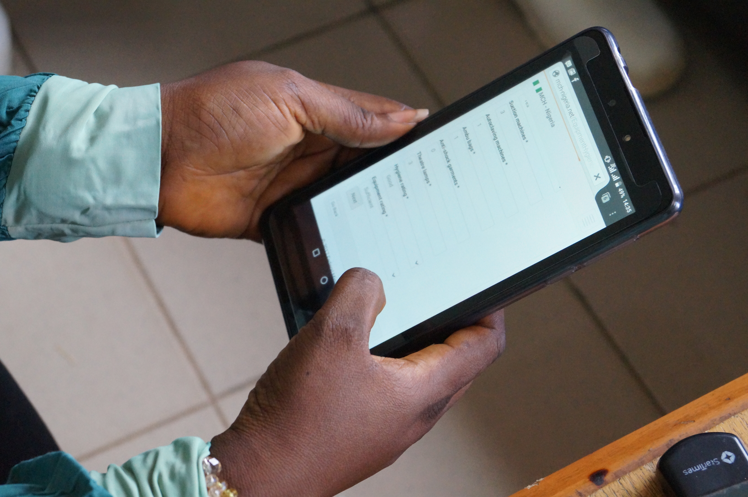
Digitalisation and Sustainability
Current Method
New Method

Slide 12
Population Growth - Family Planning
RFPD’s Mission since its establishment 20 years ago:
Family Planning supports the rights of women and girls to decide for themselves – whether, when and how many children they want to have
An estimated 214 Mio. women and girls worldwide have an unmet need for modern contraception
It’s time to take action!
Improve the access to Family Planning Services (especially for adolescents)
Activate the youth potential → start harnessing the demographic dividend
Empower women (better health care, quality education, more income)

Slide 13
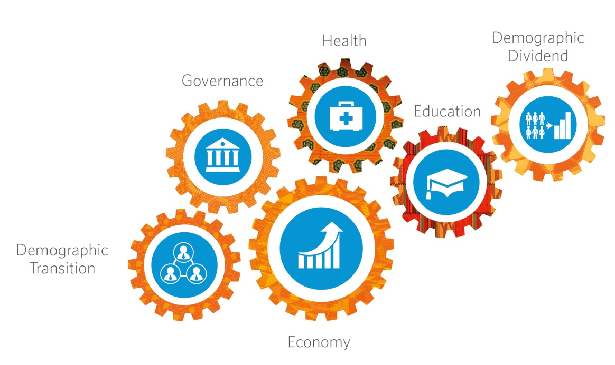
Harnessing the Demographic Dividend
G 20 – Investment Partnership
Summit African Union and EU Nov. 2017
Precondition:
Investments – Marshall Plan with Africa
Dual Education – supported by Rotary
Family Planning – supported by RFPD

Slide 14
Strengthening National Health Systems - to bring about and sustain Human Dignity
Rotary project part of the Nigerian Health System (“Sustainability of Sustainability”)
Capacity building by knowledge transfer
Extending access to professional Family Planning services
Initiating electronic, reliable data collection and analysis
Web based MPDSR enables expansion of quality assurance system
In high/middle income countries QA System in Health Care started in Obstetrics Therefore entire Nigerian Health System can be strengthened in near future

Slide 15
RFPD`s project Impact
Instructing hospitals and their staff to introduce Obstetric Quality Assurance
Training doctors and midwives in analysis of digital data
Systematically analysing digital data on three levels (national, state, hospital)
Improving the access to family planning services and modern contraceptives
Providing Equipment, Birth Kits, modern Contraceptives and Mosquito Nets
Sustainably reducing
Maternal and Newborn mortality and morbidity

Slide 16
Project proposals
Replication of ‘Obstetric Quality Assurance’ (RFPDs Model project)
● Impact of the project:
Reduction of Maternal Mortality by 60% and Fetal mortality by 15 % within three years
Current replications are planned in Rwanda and Tamil Nadu, India
By Strengthening the Health Systems and offering development aid we can respect, protect and defend human dignity.
Replication of ‘Postpartum Family Planning’ (RFPDs Model project)
Successful Global Grant Pilot Project in Pakistan
GG with ca. 30.000 US$, ideal for club level
Needs assessment 5%, project impact 35% of women have access to FP Services

Slide 17
Why should Norway set up an RFPD Section
How Rotarian Action Groups help
Offer project ideas
Support finding a host club
Advocate with governments
Help to obtain Cofunding by government agencies
What is unique about Rotarian Action Groups
Open Membership
RAGs function independently
Group members with passion share their expertise

Slide 18
Benefits of a RFPD Section in Norway
Rotarians can engage in meaningful service activities supporting MCH
Rotarian Action Groups help clubs and districts to obtain funding
Clubs/Districts gain support from experts for planning/implementing projects
In April 2018 Trustees are supposed to approve grant model large scale projects
- A substantial support of RAGs activities -

Slide 19
Summary
► Make a difference with family planning + large scale projects
► Emphazise projects that enhance Human Dignity
► Large Scale Projects requested by RI + facilitated by RAGs
► Rotarian Action Groups bring expertise together
► Start with Action Group RFPD for MCH
→ Together you are strong and Make a Difference

